Slide 1


Slide 2

Agenda
Intro Raspberry Pi
Intro Arduino
Programming Arduino
Basic electronics
What to build ?

Slide 3

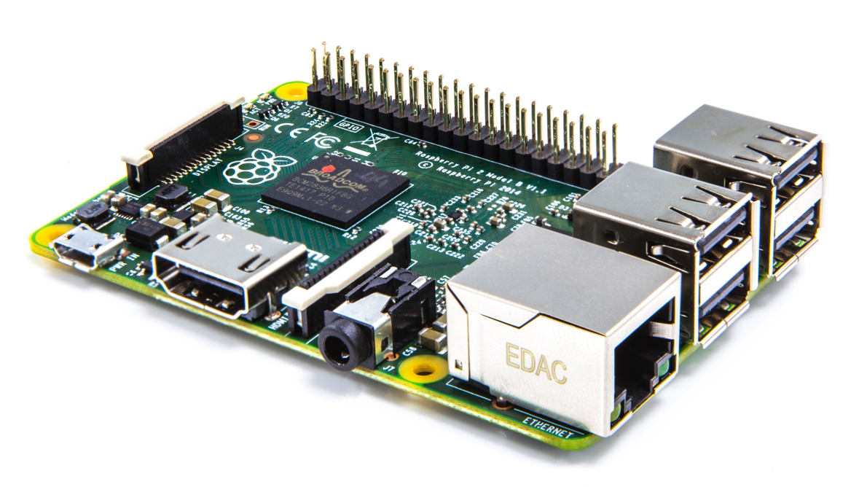
Raspberry Pi
Low cost computer, ARM processor
OS
Linux ports (Raspbian, PiDora, RaspBMC, …)
Windows 10 coming soon (PI 2 only)
GPIO
Display (DSI)
USB
HDMI
Camera (CSI)
Audio
Ethernet

Slide 4

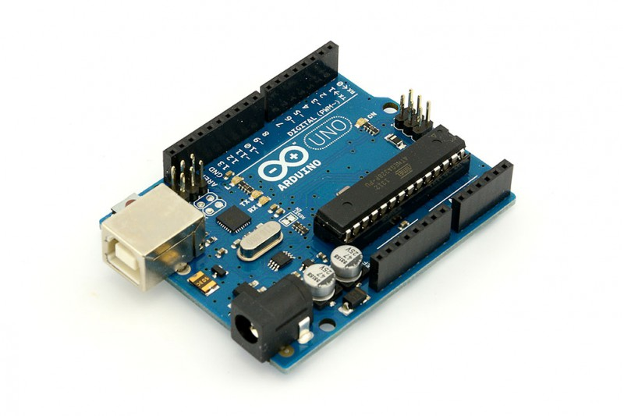
Arduino
Microcontroller board (several types)
No OS, limited instruction set
Extensible hardware (ie. shields)
Digital Input /Output
Analog Input
I2C
USB
Power
Power

Slide 5
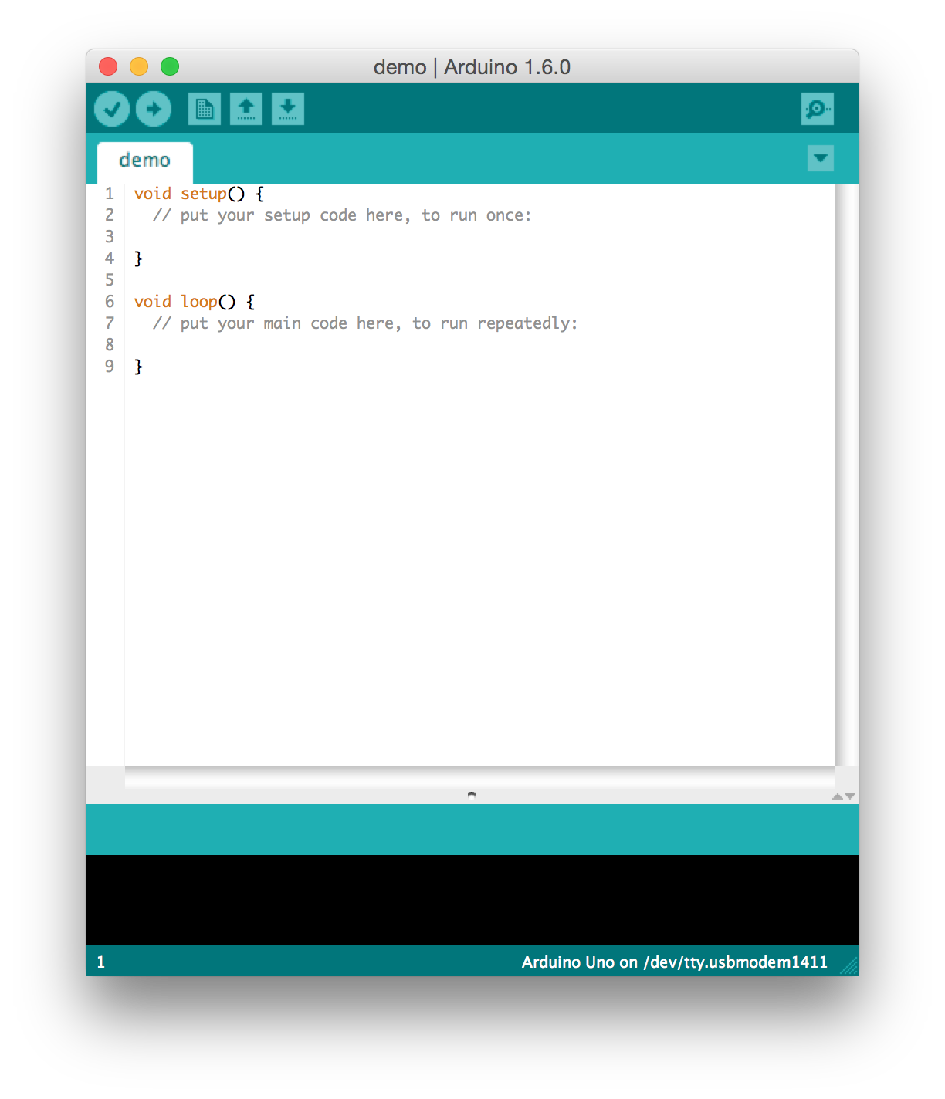
Programming Arduino
Arduino IDE
Lots of examples available
in IDE (File – Examples)

Slide 6
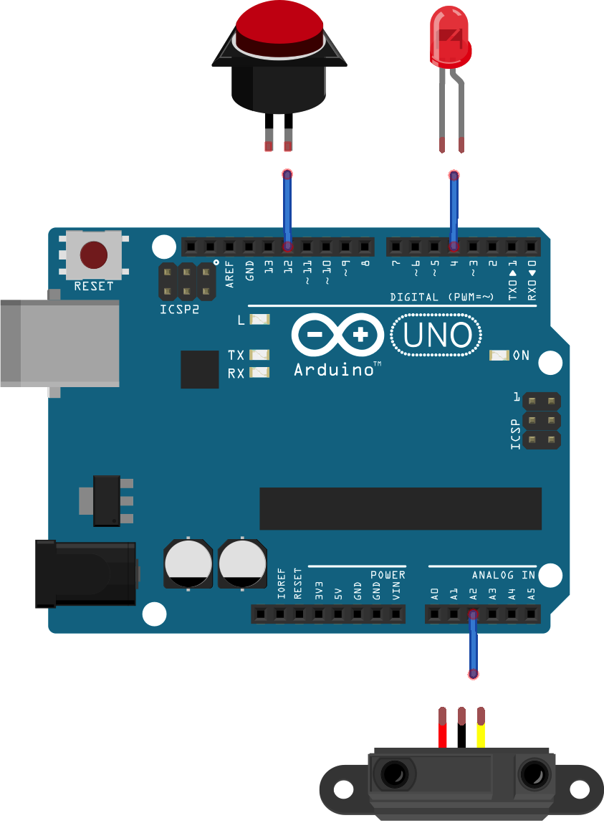
Programming Arduino
Use case:
When pressing a button
a LED is switched on when an
object is within a certain range
12
4
A2

Slide 7
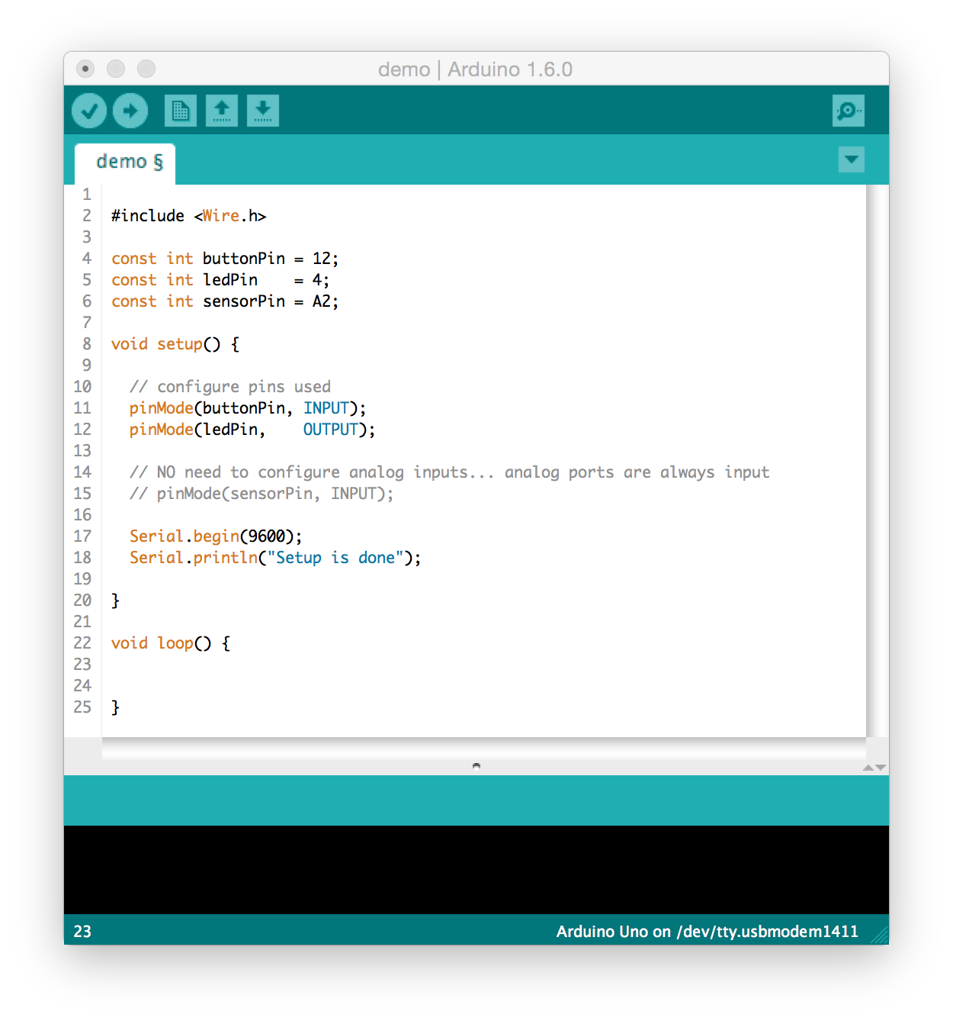
Programming Arduino
setup()
Called when a sketch starts.
Use it to initialize variables,
pin modes, start using libraries, etc.
Setup() will only run once.

Slide 8
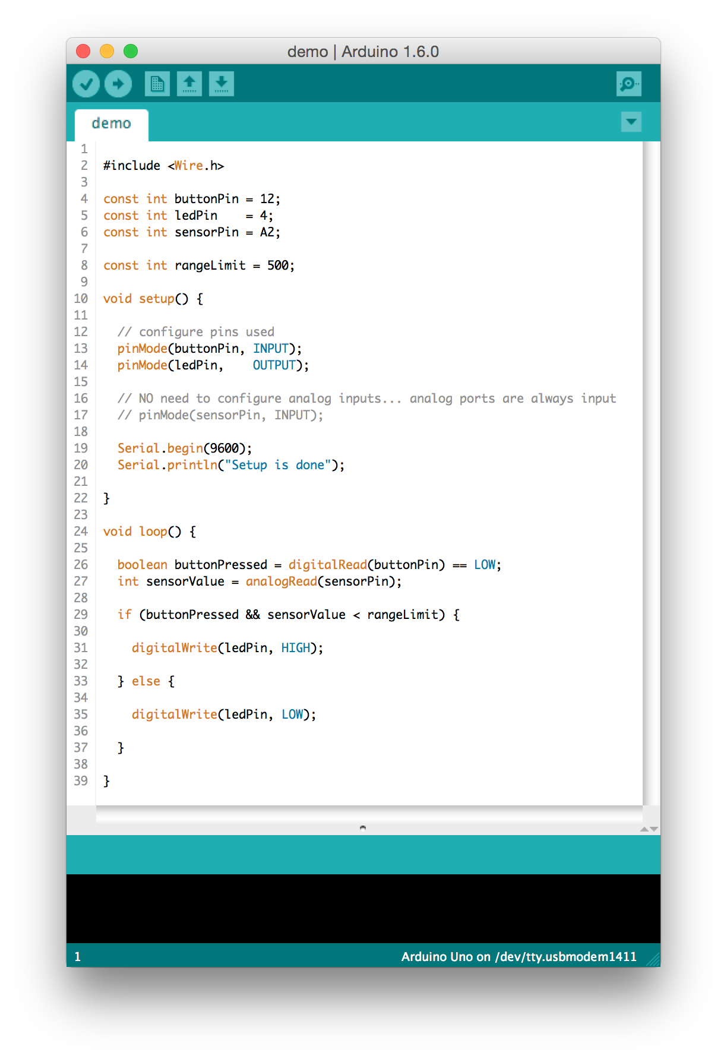
Programming Arduino
loop()

Slide 9
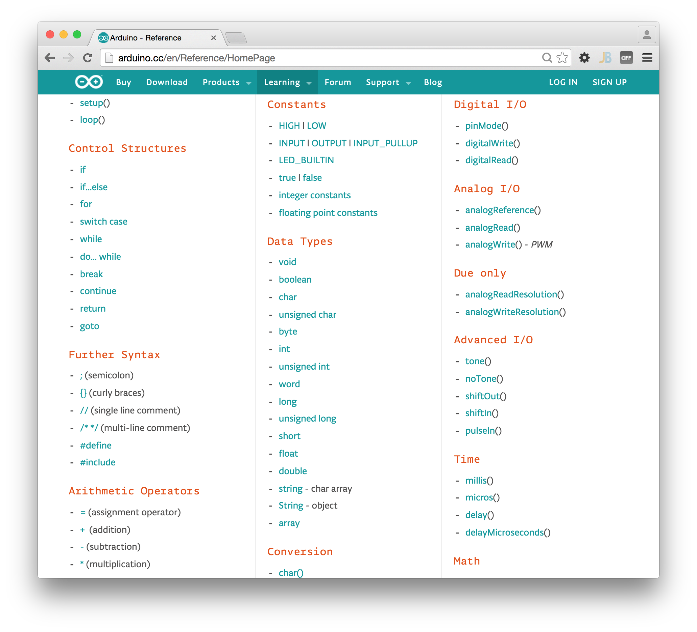
Programming Arduino
http://arduino.cc/en/reference/homePage

Slide 10
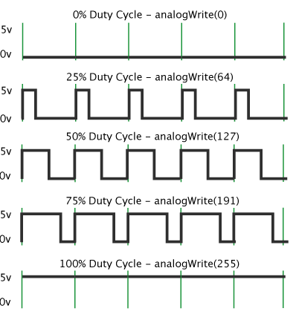
Programming Arduino
PWM
(Pulse Width Modulation)

Slide 11
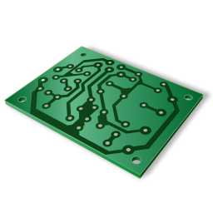

Basic electronics
Caution
Max 40 mA pin current
Recommended max. 20 mA pin current for continuous use

Slide 12
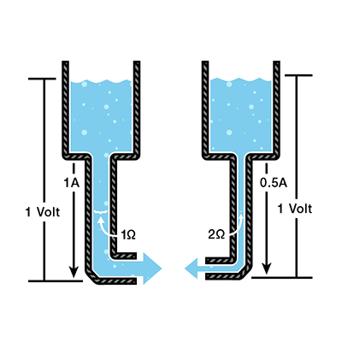
Basic electronics
U = I x R

Slide 13
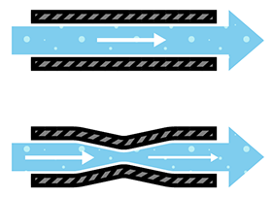
Basic electronics
Resistor
Limit current

Slide 14
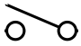
Basic electronics
Resistor
Arduino
Floating input

Slide 15
Basic electronics
Resistor
5 V
10 KΩ
Arduino
Pull-up

Slide 16
Basic electronics
Resistor
5 V
Arduino
Pull-up

Slide 17
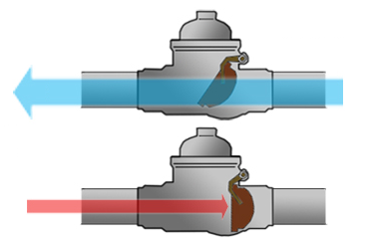
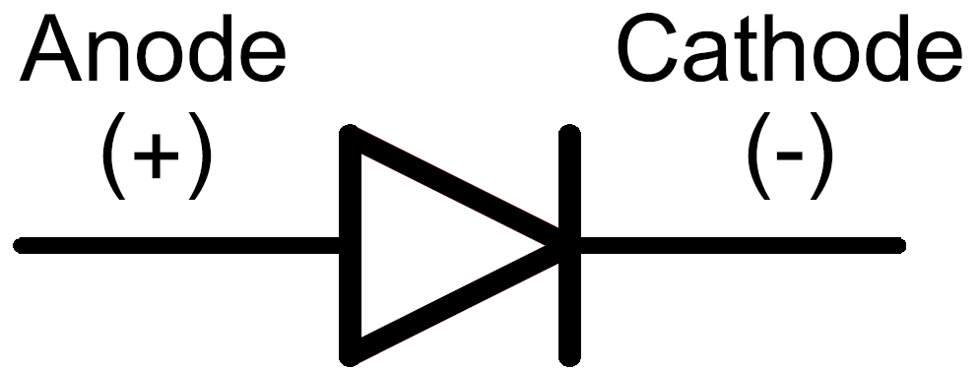
Basic electronics
Diode
+ -

Slide 18
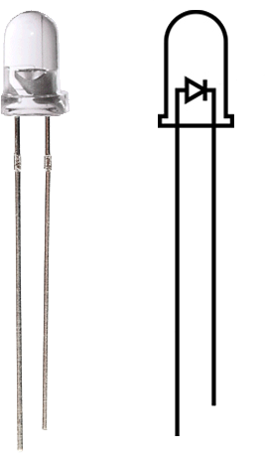
Basic electronics
LED
-
+

Slide 19
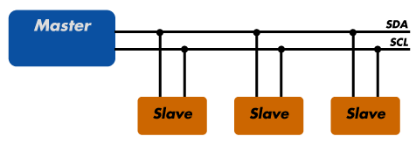
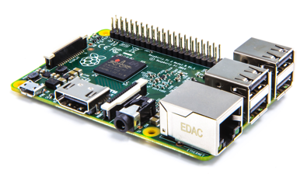
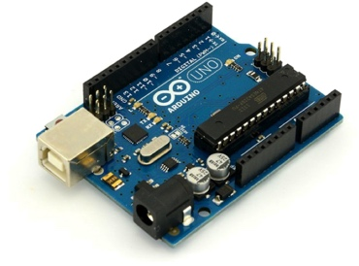
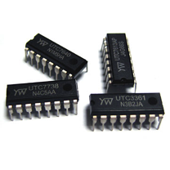
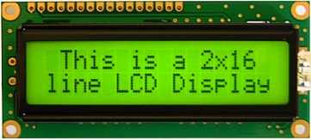
Basic electronics
I2C bus
Master - generates clock signal and initiates communication with slaves
Slave - receives clock and responds when addressed by the master

Slide 20
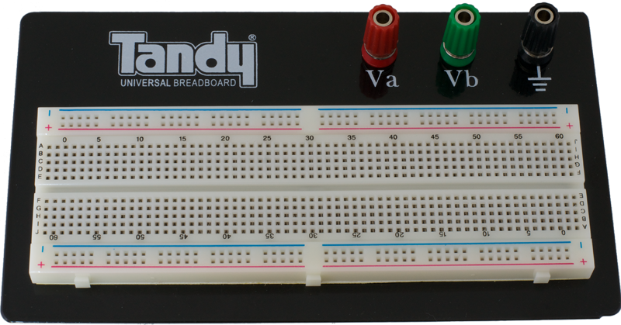
Basic electronics
Breadboard

Slide 21
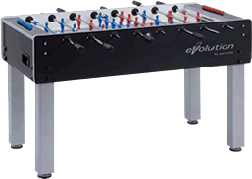
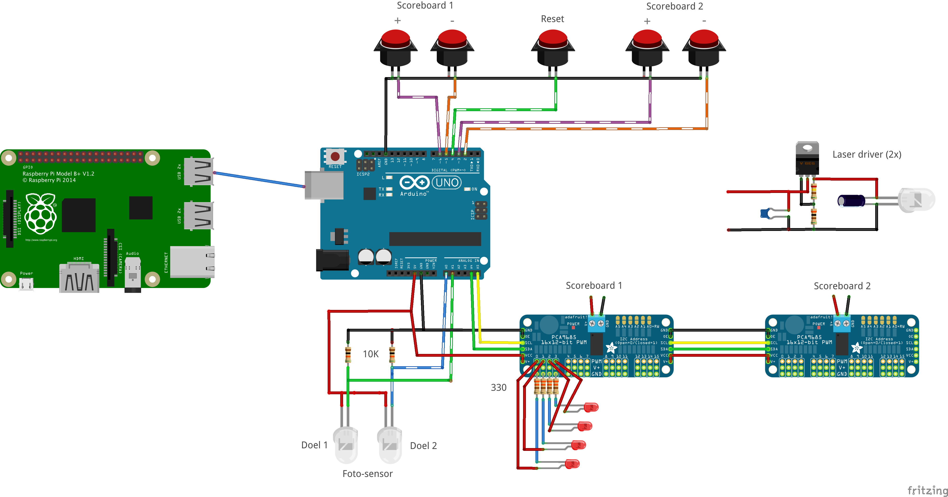
What to build?

